Slide 1

Sentimental Analysis
NLP
PRESENTED BY
GROUP-4
Poojashree V
Thillaikarasi R
Nida Fatima Md Irfan
Vandhana Jhala
Raghavendra Rao Cheekati
Gode Krishna Durga Prasad
Devanshi Ajay Shrivastava

Slide 2
Introduction
Objective:
To classify customer reviews into positive, negative, and neutral sentiments.
Tools and Technologies:
Python,
NLTK,
VADER Sentiment Analyzer,
Scikit-learn, Streamlit.

Slide 3
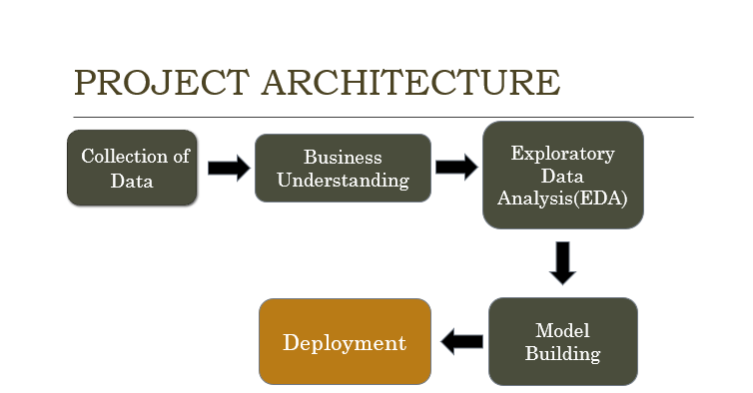

Slide 4

What is Sentimental Analysis?
The process of computationally identifying and categorizing opinions expressed in a piece of text, in order to determine whether the writer's attitude towards a particular topic, the product is positive, negative, or neutral.

Slide 5
Dataset
Description:
Source : scraped/extracted from ecommerce website (amazon)
Key features: Headline, Review, Ratings.
Preprocessing:
Handling missing values and duplicates.
Text cleaning and preprocessing.

Slide 6
Data Preprocessing
Steps:
Removing special characters and numbers.
Converting text to lowercase.
Tokenizing and lemmatizing.
Removing stopwords.
Libraries Used:
NLTK for text processing.
pandas for data manipulation.

Slide 7
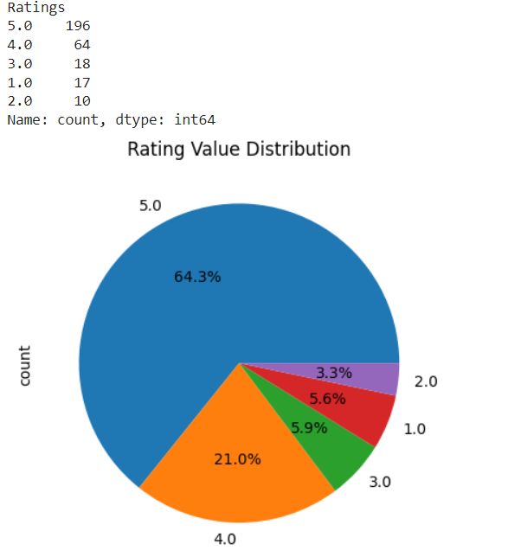
EDA(Exploratory data analysis )
(EDA) is used by data scientists to analyze and investigate data sets and summarize their main characteristics, often employing data visualization methods.

Slide 8
Sentiment Analysis
VADER Sentiment Analyzer:
Explanation of VADER.
How sentiment scores are calculated.
Classifying sentiments based on scores (Positive, Negative, Neutral).

Slide 9
Handling Imbalance
SMOTE (Synthetic Minority Over-sampling Technique):
Explanation of SMOTE.
Why it's used for handling class imbalance.
Application on the training dataset.

Slide 10
Model Building
MODEL:
Random Forest Classifier.
Number of estimators and random state.
VECTORIZATION:
TF-IDF Vectorizer.
Conversion of text data into numerical features.

Slide 11
Model Training and Evaluation
Training:
Training the model on the resampled dataset.
X = df_1['cleaned_text']
y = df_1['sentiment']
X_train, X_test, y_train, y_test = train_test_split(X, y, test_size=0.3, random_state=42)
Evaluation:
Confusion Matrix.
Classification Report.
Accuracy Score.

Slide 12
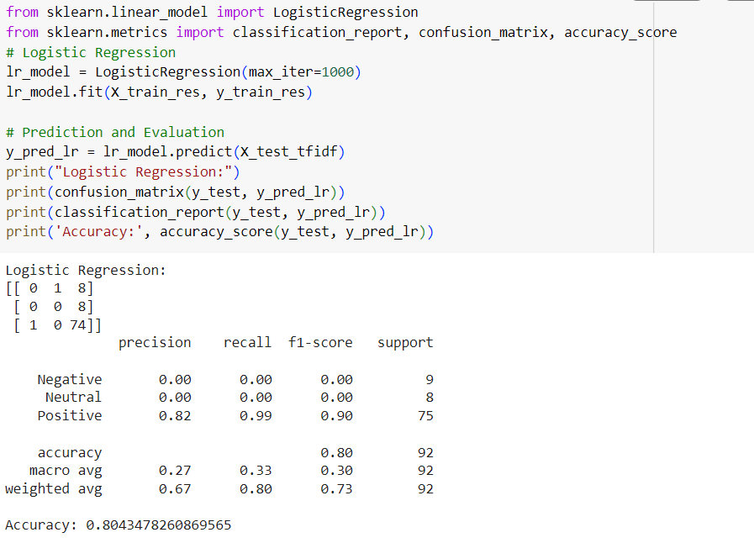
LOGISTIC REGRESSION

Slide 13
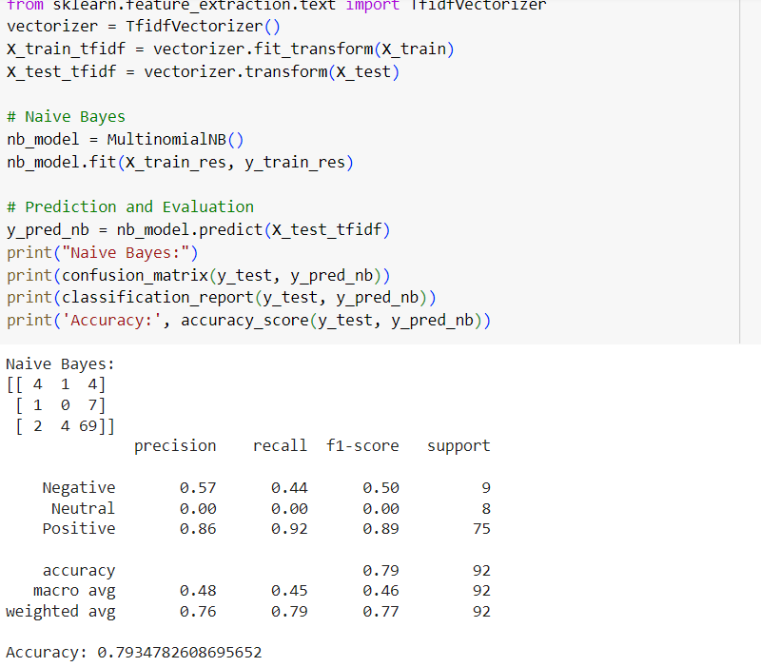
NAÏVE BAYES

Slide 14
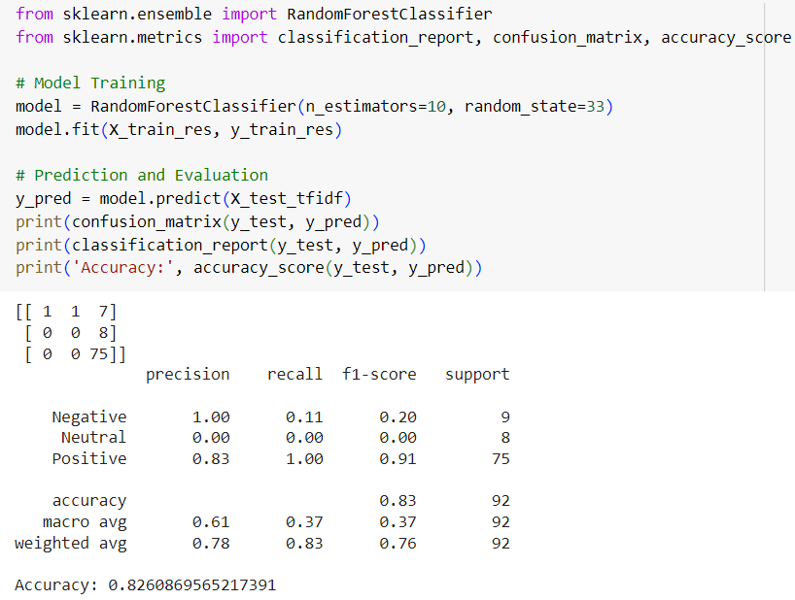
RANDOM FOREST

Slide 15
Streamlit Application
Creating interactive dashboards to explore and visualize datasets.
Displaying complex charts and graphs with real-time updates.
Building web interfaces to deploy and interact with machine learning models.
Allowing users to input data and see model predictions directly through the app
Creating custom data applications tailored to specific business needs.
Integrating with databases to fetch, display, and manipulate data.
Developing tools for performing and sharing EDA with interactive plots and tables.
Facilitating data exploration and hypothesis testing.

Slide 16
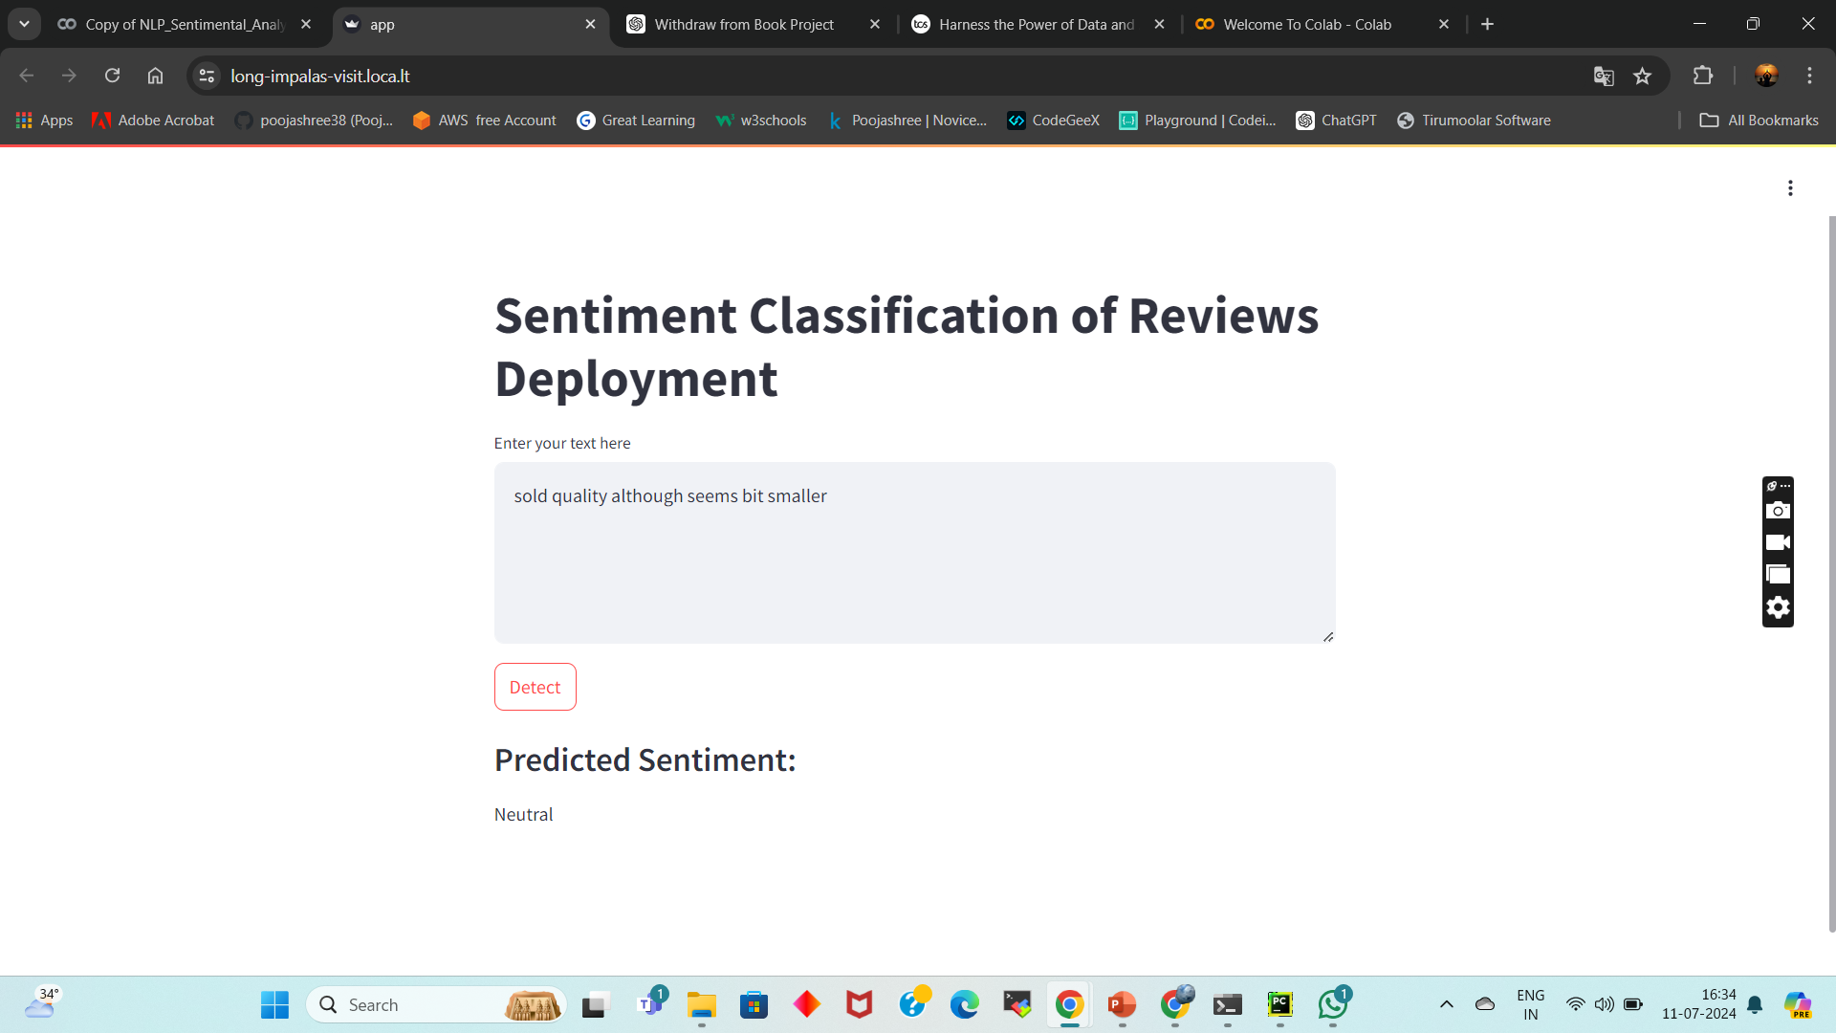
Results

Slide 17

Positive

Slide 18

Negative

Slide 19
Challenges and Solutions
Content:
Challenges:
Handling imbalanced data.
Processing large text data.
Solutions:
Use of SMOTE.
Efficient text preprocessing techniques.

Slide 20
Conclusion
Summary:
Importance of sentiment analysis in customer feedback
Analysing Emotions
Future Work:
Possible improvements and next steps.

Slide 21
Thank you

